Slide 1
.NET

Slide 2
What is .NET?
It is a framework to develop software applications. It is designed and developed by Microsoft and the first version released in 2000.
It is used to develop applications for web, windows, phone.

Slide 3
Which technologies are supported by the .NET framework?
ASP.NET
WinForms (Windows Forms)
WPF (Windows Presentation Foundation) - rich desktop app
Console Application
Windows Services
ASP.NET Core
EF
ADO.NET - manipulating data in database
WCF
WF
WIF

Slide 4
What does the .NET ecosystem provide?
The .NET ecosystem is a comprehensive platform developed by Microsoft for building and running various types of applications, ranging from web applications and services to desktop applications, mobile apps, cloud-based solutions, and more. The .NET ecosystem provides a rich set of tools, frameworks, libraries, and services to support application development across different domains.

Slide 5
Components of .NET
Key components and offering within the .NET ecosystem:
.NET Framework – building windows app, web app and services.
.NET Core – cross platform, framework for building cloud, cross platform app.
ASP.NET – development for dynamic web app, web APIs and services
ASP.NET Core – building modern, cross platform, and cloud based web app.
Entity Framework – ORM for simplifying database interaction in .NET app.
Xamarin – for mobile app using .NET languages like c#.
Blazor – building web app like C# and .NET instead of JS. Used for Client & Server dev.
Azure Devops
Visual Studio -
NuGet - manage dependencies

Slide 6
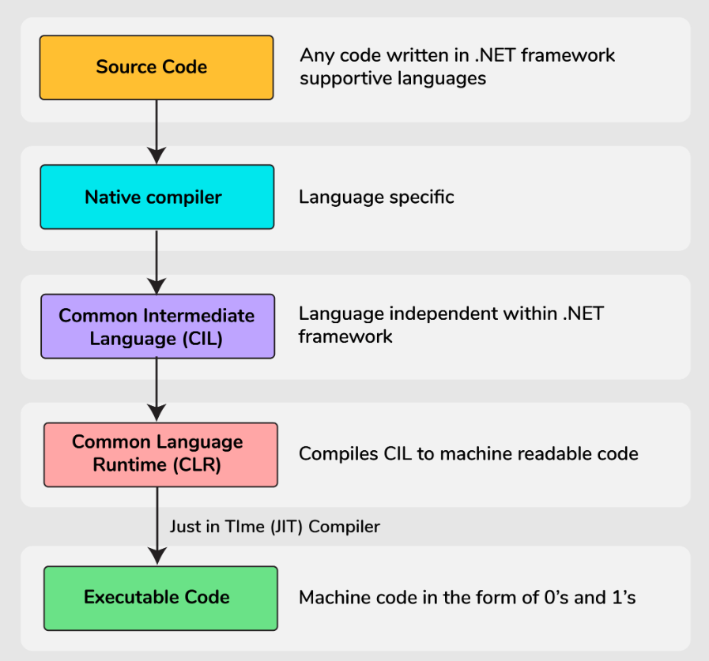
How does the .NET Framework work ?
.NET framework based applications that are written in supportive languages like C#, F#, or VB are compiled to Common Intermediate Language (CIL).
Compiled code is stored in the form of an assembly file that has a .dll or .exe file extension.
When the .NET application runs, Common Language Runtime (CLR) takes the assembly file and converts the CIL into machine code with the help of the JIT(Just in Time) compiler.
Now, this machine code can execute on the specific architecture of the computer it is running on.

Slide 7
Major components of the .NET Framework
Common Language Runtime
Framework Class Library
Base Class Library
User defined class Library
Assembly
Pre defined class library
Namespace
Common Type System
Common Language Specification

Slide 8
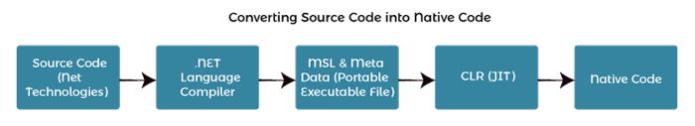
Common Language Runtime
It is an execution engine that runs the code and provides services that makes the development process easier.
Services provided by CLR are memory management, garbage collection, type safety, exceptional handling, security and thread management. It also makes it easier for designing the app and components whose objects interact across the language.
The programs written for the .NET framework are executed by the CLR regardless of programming language.

Slide 9
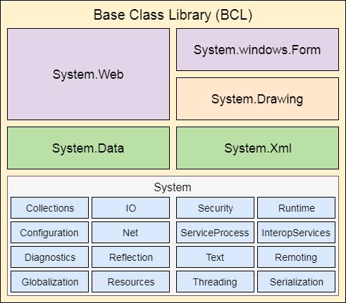
Framework class Library
It has pre – defined method and properties to implement common and complex functions that can be used by .NET applications.
It will also provide types for dates, string, numbers, etc.
This class includes APIs for database connections, file reading, and writing, drawing etc.

Slide 10
Base Class Library
It is a huge collection of libraries features and functions that are helpful in implementing various programming languages such as C#, F#.
BCL is divided in 2 parts
User Defined class library : It includes Assemblies. Assembly is a logical unit of code, which is used for security, deployment, and versioning. Assembly can be defined in two forms namely dll or exe.
Predefined class library: it contains namespace. Namespace is the collections of pre-defined method and classes that are present in the .NET framework. A namespace can be added to a .NET program with the help of “using System”, where using represents a keyword and system represents a namespace.

Slide 11
Common Type System
It specifies standard that will mention which type of data and value can be defined and managed in memory during runtime.
It will make sure the programming data defined in different languages should interact with each other for sharing the information.
Prevent data loss when we are trying to transfer data from a type in one language to its equivalent type in another language.

Slide 12
Common Language Specification
It is a subset of CTS and defines a set of rules and regulations to be followed by every .NET framework language.
A CLS supports inter-operability or cross language integration, which means it provides a common platform for interacting and sharing information. For ex, every programming language (C#, F#, VB, VB.NET etc.) under the .NET framework has its own syntax. So, when statements belonging to different languages get executed, a common platform, will be provided by the CLS to interact and share the information.

Slide 13
What is JIT?
JIT stands for Just in Time. It is a compiler that converts the intermediate code into the native language during the execution.

Slide 14
What is Microsoft Intermediate Language?
MSIL is the Microsoft Intermediate Language, which provides instructions for calling methods, memory handling, storing, and initializing values, exception handling and so on.
The instructions provided by MSIL are platform independent and are generated by the language specific compiler from the source code. JIT

Slide 15
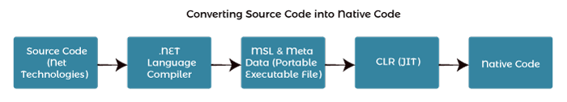
CLR
That language's compiler compiles the source code of applications developed using .NET compliant languages into CLR's intermediate language called MSIL, i.e., Microsoft intermediate language code. This code is platform-independent. It is comparable to byte code in java.
Metadata is also generated during compilation and MSIL code and stored in a file known as the Manifest file. This metadata is generally about members and types required by CLR to execute MSIL code.
A just-in-time compiler component of CLR converts MSIL code into native code of the machine. This code is platform-dependent. CLR manages memory, threads, exceptions, code execution, code safety, verification, and compilation.

Slide 16
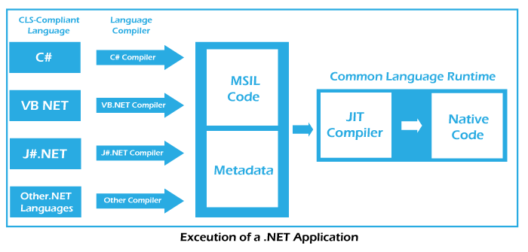
Components of CLR
Common Type System
Common Language Speciation
Garbage Collector
Just in Time Compiler
Metadata and Assemblies

Slide 17
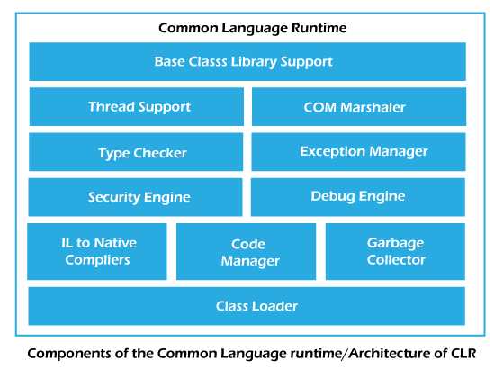
.NET CLR Structure

Slide 18
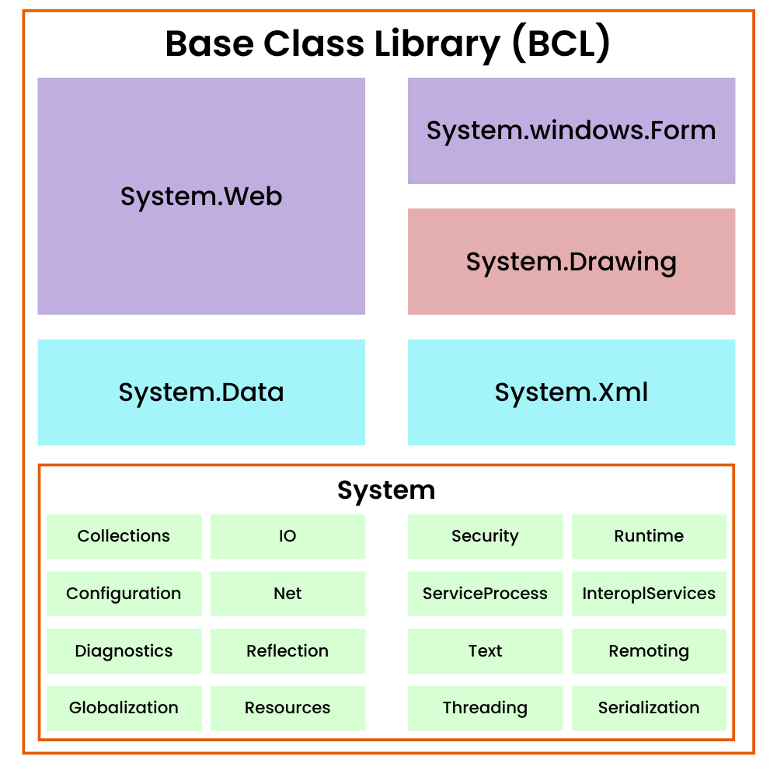
Base Class Library Support
It is a class library that supports classes for the .NET application.

Slide 19
Thread Support
The CLR provides thread support for managing the parallel execution of multiple threads.
The System.Threading class is used as the base class for this.

Slide 20
COM Marshaler
COM Marshaler refers to the component responsible for facilitating communication between managed code (code written in languages like C#) and unmanaged code (code written in languages like C++ or COM components). COM stands for Component Object Model, a binary interface standard for software components.
When managed code needs to interact with unmanaged code or COM components, the COM Marshaler plays a crucial role in managing the transition between the two environments.
Unmanaged code - requires only one complication code

Slide 21
Security Engine
The security engine in the CLR handles the security permissions at various levels such as the code level, folder level, and machine level. This is done using the various tools that are provided in the .NET framework.

Slide 22
Type Checker
Type safety is provided by the type checker by using the Common Type System (CTS) and the Common Language Specification (CLS) that are provided in the CLR to verify the types that are used in an application.

Slide 23
Code Manager
It manages code at execution runtime.
The code manager in CLR manages the code developed in the .NET framework i.e. the managed code. The managed code is converted to intermediate language by a language-specific compiler and then the intermediate language is converted into the machine code by the Just-In-Time (JIT) compiler.

Slide 24
Garbage Collector
It releases the unused memory and allocates it to a new applications.
Automatic memory management is made possible using the garbage collector in CLR. The garbage collector automatically releases the memory space after it is no longer required so that it can be reallocated.

Slide 25
Exception Handler
It handles the exception to runtime to avoid application failure.
The exception manager in the CLR handles the exceptions regardless of the .NET Language that created them. For a particular application, the catch block of the exceptions are executed in case they occur and if there is no catch block then the application is terminated.

Slide 26
ClassLoader
It is used to load all classes at runtime.
Various modules, resources, assemblies, etc. are loaded by the CLR loader. Also, this loader loads the modules on demand if they are actually required so that the program initialization time is faster and the resources consumed are lesser.

Slide 27
Build/ Rebuild/clean
Build:
Purpose: The "Build" option compiles the source code that has changed since the last build. It performs an incremental build, meaning it only compiles the files that have been modified or added since the last successful build.
Result: The compiled output is updated in the "bin" directory, and only files that have changed are recompiled.
Rebuild:
Purpose: The "Rebuild" option is more comprehensive. It cleans the entire project, removing all previously compiled files (including those in the "bin" and "obj" directories), and then rebuilds the entire project from scratch.
Result: The entire project is recompiled regardless of whether files have changed or not. It ensures a clean build by starting the compilation process anew.
Clean:
Purpose: The "Clean" option is different from "Rebuild" in that it cleans the project by removing all previously compiled files (both in the "bin" and "obj" directories) without initiating a build.
Result: It deletes all previously compiled files, leaving the project in a state as if it hasn't been built. Subsequent builds will then recompile the entire project.

Slide 28
Use Cases
Build: Use this when you want to compile only the changes made since the last build, providing a quicker compilation process.
Rebuild: Use this when you want to perform a clean build of the entire project, ensuring that all files are recompiled from scratch. This can be helpful if you suspect issues related to the build process.
Clean: Use this when you want to remove all previously compiled files without initiating a build. This can be useful when you want to start with a clean slate without actually rebuilding the project.

Slide 29
what is solution explorer in vs ?
In Visual Studio, the Solution Explorer is a tool window that provides a hierarchical view of the files, projects, and solutions within your current development environment. It offers a structured representation of the components of your solution, making it easy to navigate, manage, and organize your code and related files.

